Slide 1
FPGA PROJECT
SIDDHANT DEORE, IMT2023539
VINAY.P.RAMESH, IMT2023541

Slide 2
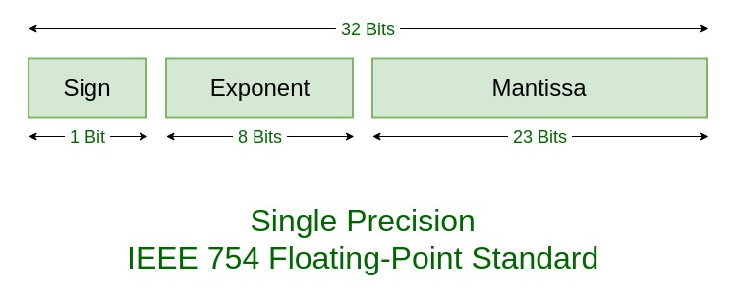
IEEE 754 FLOATING POINT NUMBERS
Example:
85.125
85 = 1010101
0.125 = 001
85.125 = 1010101.001
=1.010101001 x 2^6
sign = 0
1. Single precision:
biased exponent 127+6=133
133 = 10000101
Normalised mantissa = 010101001
we will add 0's to complete the 23 bits
The IEEE 754 Single precision is:
= 0 10000101 01010100100000000000000
This can be written in hexadecimal form 42AA4000
A single-precision FP number is: (-1)^sign × 1.frac × 2^(exp − 127)

Slide 3
GENERAL TERMS
Latency : Latency is the number of clock cycles it takes for one input to produce its corresponding output. Here, it is the time, measured in clock cycles, between asserting valid_in for an operation and receiving the corresponding valid_out with the correct result. Latency represents the delay of the pipeline. Throughput : Throughput is the rate at which the design produces results, measured as results per clock cycle (or results per second). It reflects how many independent operations the pipeline can complete every cycle after the pipeline is filled.
Resource Usage : Resource usage measures the amount of FPGA logic consumed by the design, typically reported as LUTs (Look-Up Tables), FFs (Flip-Flops), DSP blocks, and BRAMs used after synthesis and implementation.
Maximum Clock Frequency : Maximum Clock Frequency (Fmax) is the highest frequency at which the synthesized design meets timing constraints, determined by the critical path and shown in the timing report (WNS ≥ 0). Also it should be lesser than the clock cycle duration.

Slide 4
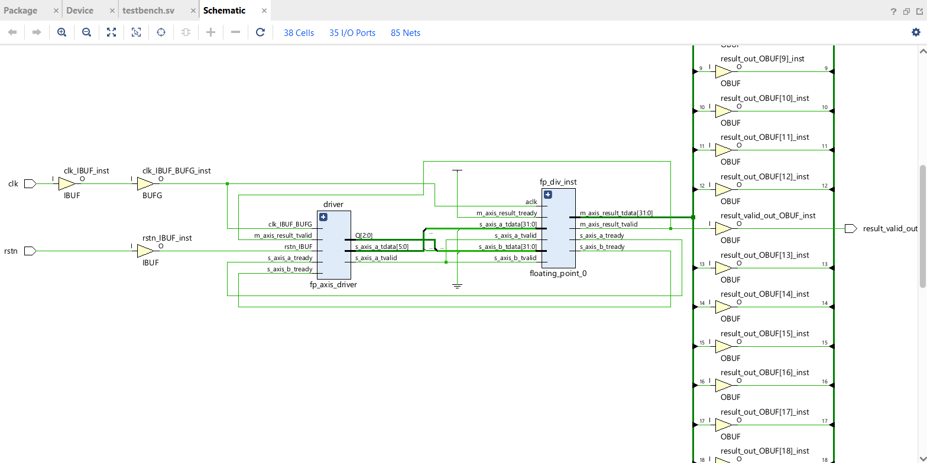
IEEE 754 FLOATING POINT IP DIVIDER
1. Schematic

Slide 5
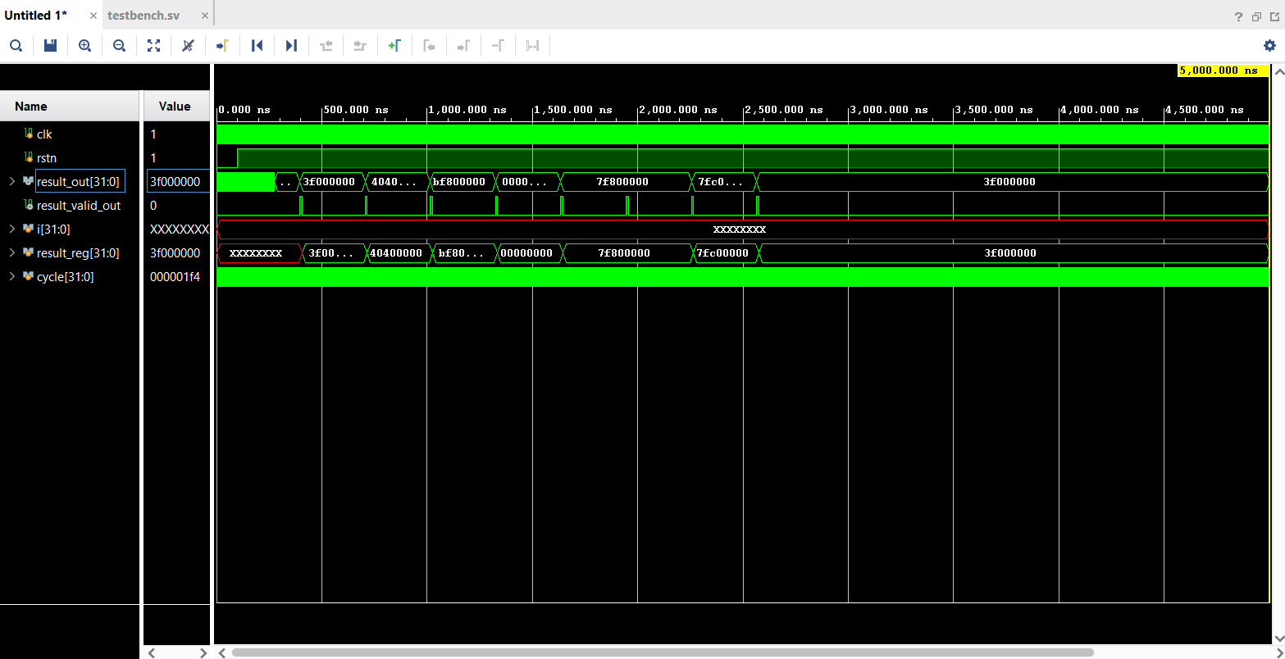
IEEE 754 FLOATING POINT IP DIVIDER
2. Waveform

Slide 6
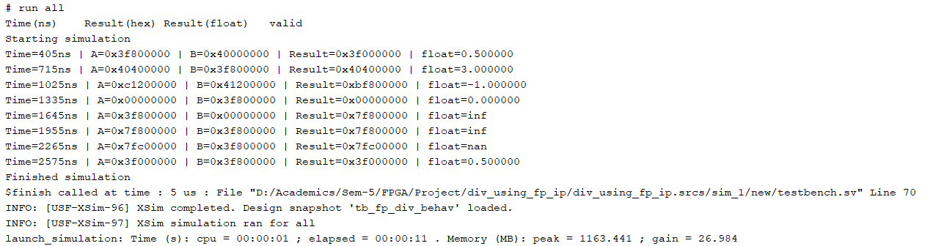
IEEE 754 FLOATING POINT IP DIVIDER
3. TCL Console Output

Slide 7
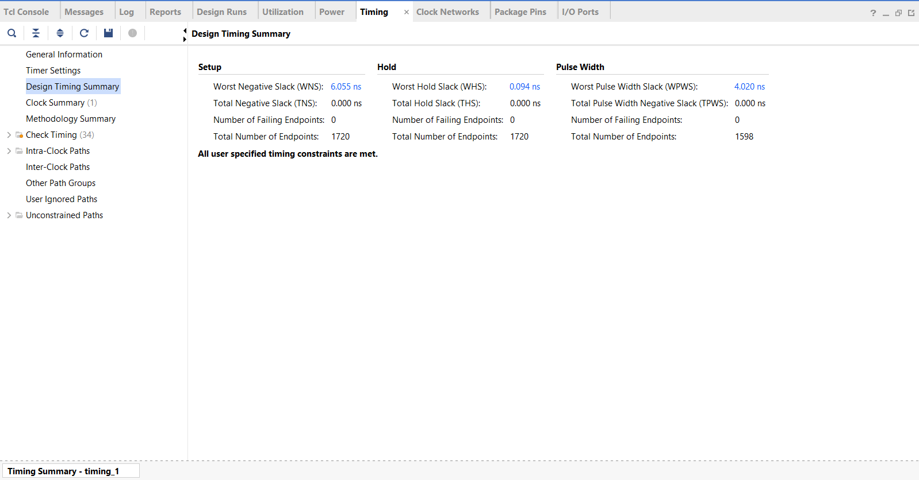
IEEE 754 FLOATING POINT IP DIVIDER
4. Design Timing Summary

Slide 8
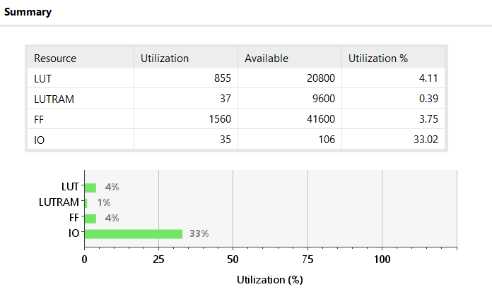
IEEE 754 FLOATING POINT IP DIVIDER
5. Utilization

Slide 9
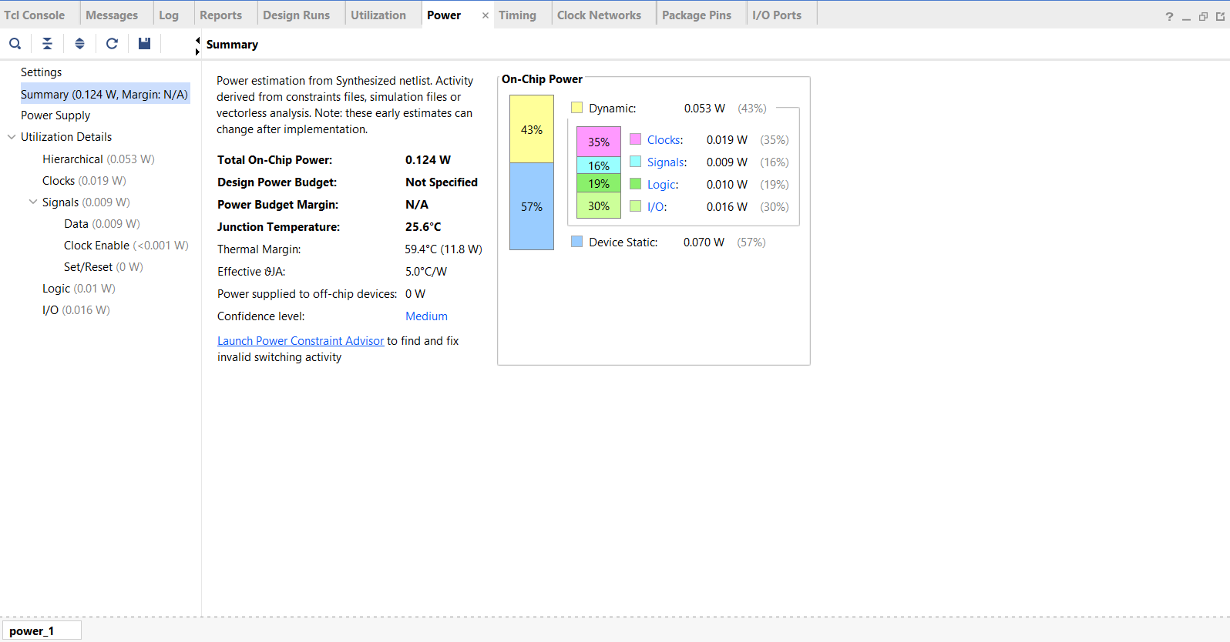
IEEE 754 FLOATING POINT IP DIVIDER
6. Power

Slide 10
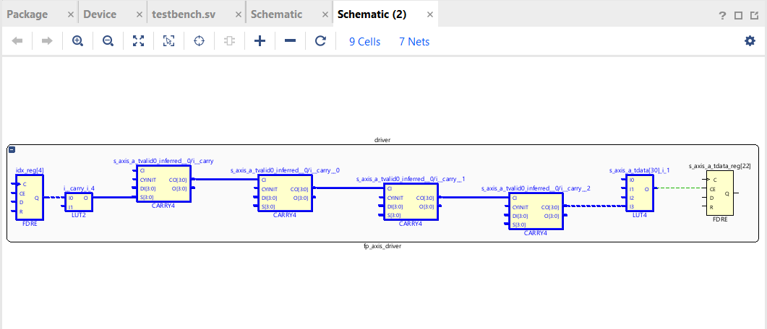
IEEE 754 FLOATING POINT IP DIVIDER
7. Critical Path
This path determines Fmax (maximum operating clock frequency). This is the bottleneck timing path of the design. The clock period must be longer than this delay.

Slide 11
SUBTRACTIVE NON-PIPELINED DIVIDER
Logic explanation using an example:
Convert operands to IEEE-754
A = 6.0 → 0x40C00000
B = 2.0 → 0x40000000
2. (-1)^sign × (1.mantissa) × 2^(exponent − 127)
3. Extract fields
signA = 0, exponentA = 129, mantissaA = 1.100000…
signB = 0, exponentB = 128, mantissaB = 1.000000…
4. Compute sign
sign = signA XOR signB = 0
5. Compute exponent
real exponent = exponentA − exponentB = 129 − 128 = 1
stored exponent = real exponent + 127 = 1 + 127 = 128 = 0b10000000
6. Mantissa division
1.100000… ÷ 1.000000… = 1.100000…
fraction field = 10000000000000000000000
7. Reassemble result
sign | exponent | mantissa
0 | 10000000 | 10000000000000000000000
= 0x40400000 = 3.0 (Hexadecimal representation)

Slide 12
FSM Stages for Non-Pipeline Subtractive Divider
State | Function
S_IDLE | wait for input
S_PREP | parse IEEE754, handle specials
S_LOAD | initialize divider
S_ITER | 24-cycle mantissa division
S_NORM | normalize output
S_DONE | assert valid_out

Slide 13
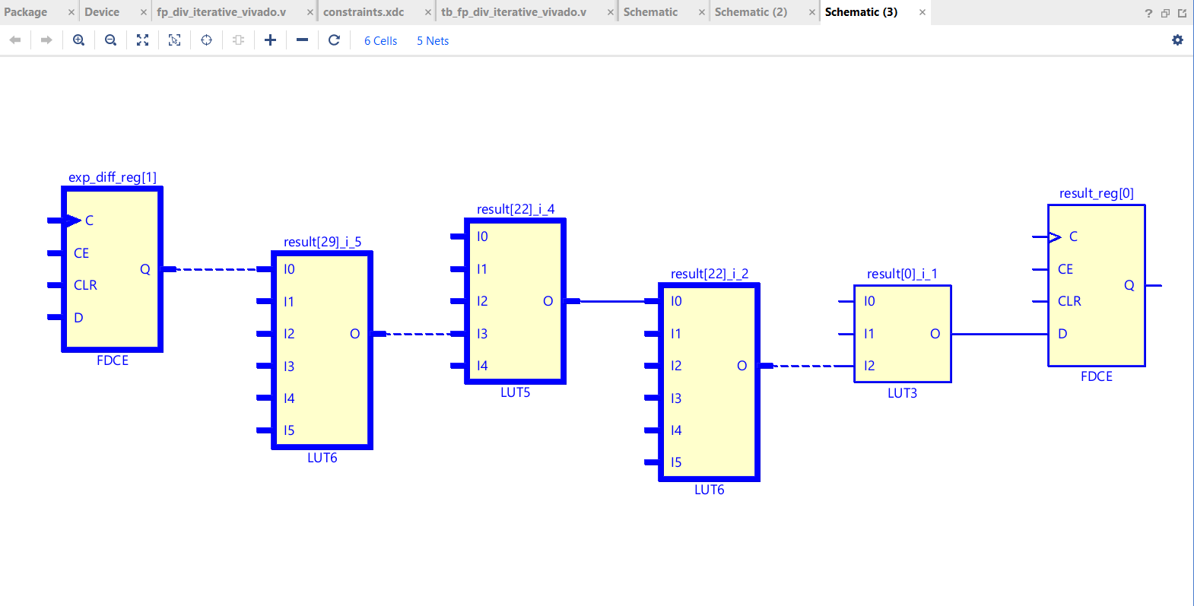
SUBTRACTIVE NON-PIPELINED DIVIDER
1. Critical Path Schematic

Slide 14
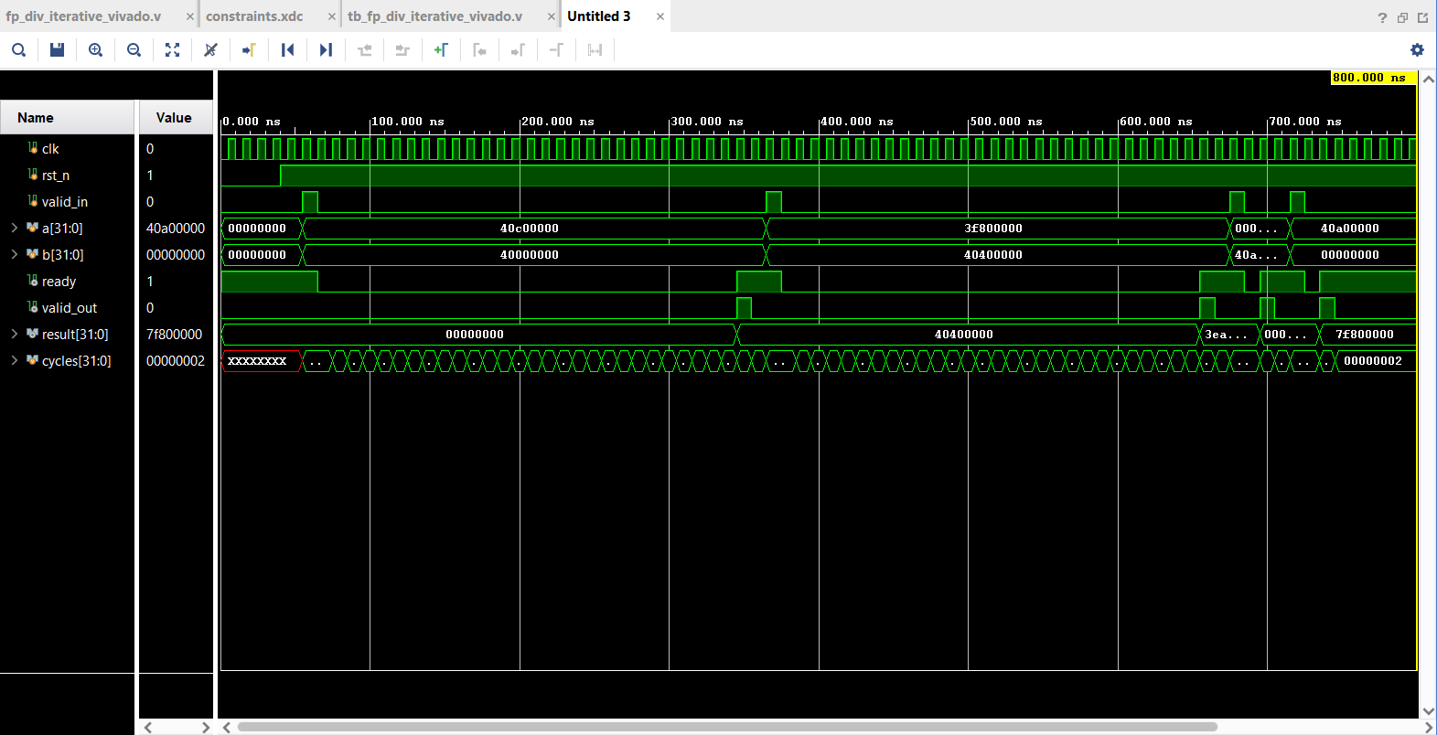
SUBTRACTIVE NON-PIPELINED DIVIDER
2. Waveform

Slide 15
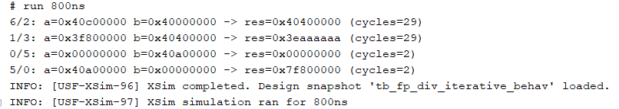
SUBTRACTIVE NON-PIPELINED DIVIDER
3. TCL Console Output

Slide 16
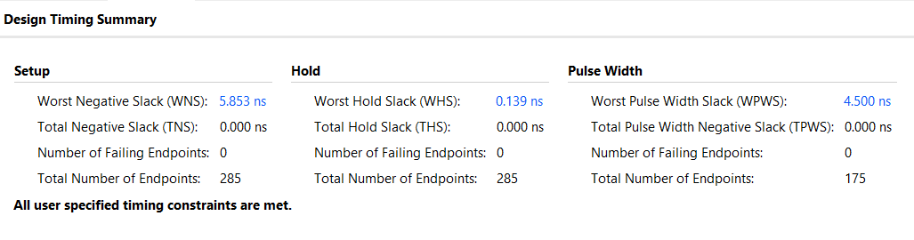
SUBTRACTIVE NON-PIPELINED DIVIDER
4. Design Timing Summary

Slide 17
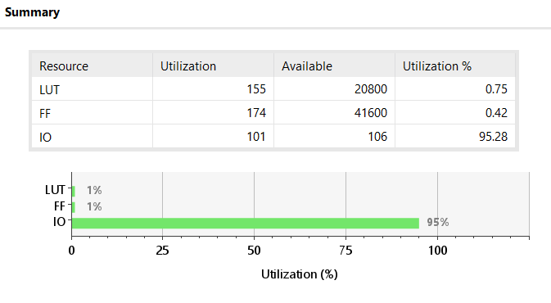
SUBTRACTIVE NON-PIPELINED DIVIDER
5. Utilization

Slide 18
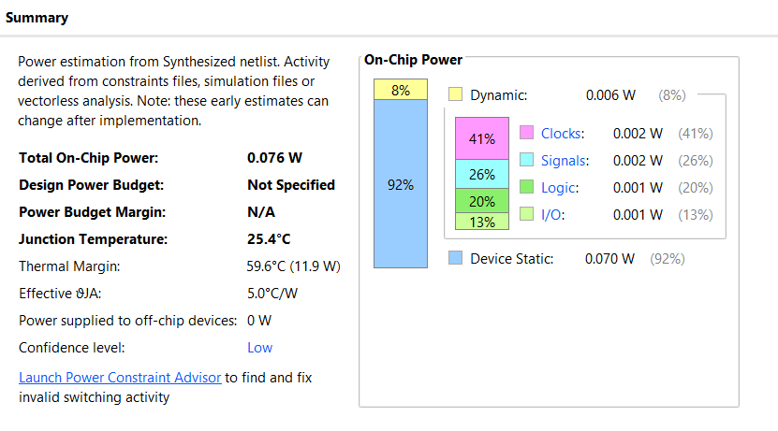
SUBTRACTIVE NON-PIPELINED DIVIDER
6. Power

Slide 19
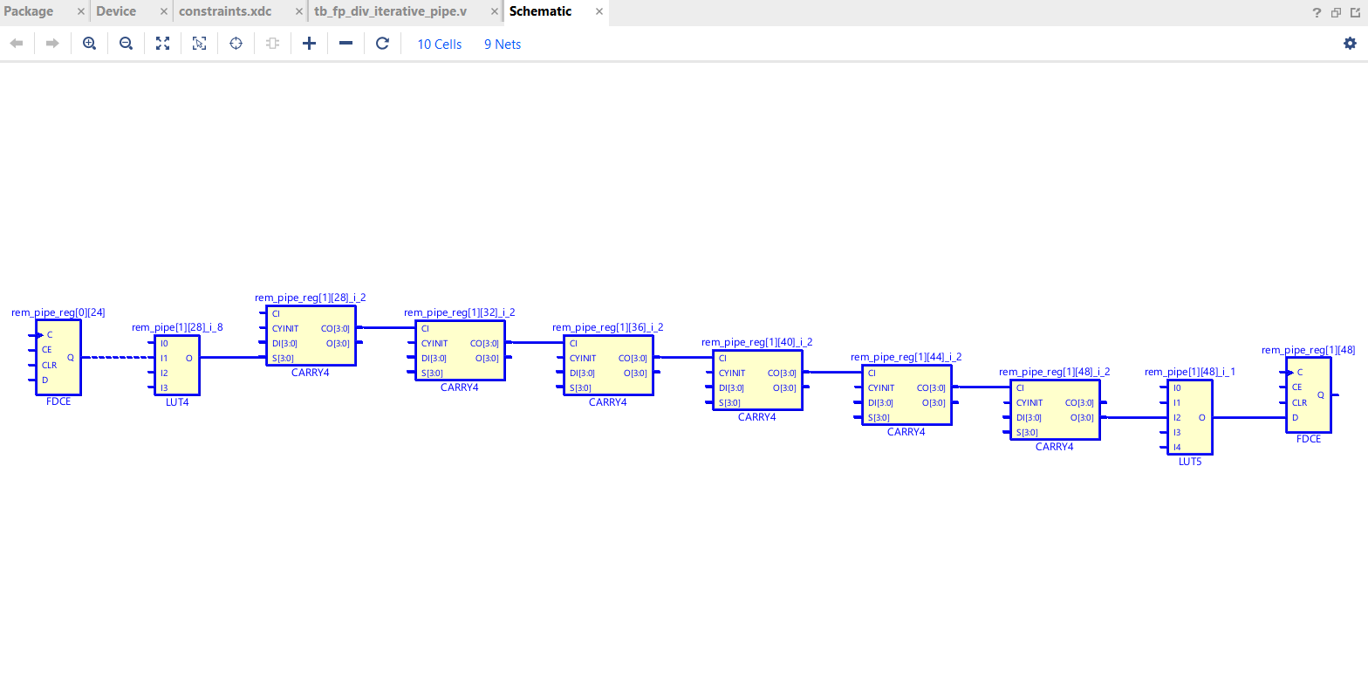
SUBTRACTIVE PIPELINED DIVIDER
1. Critical Path Schematic

Slide 20
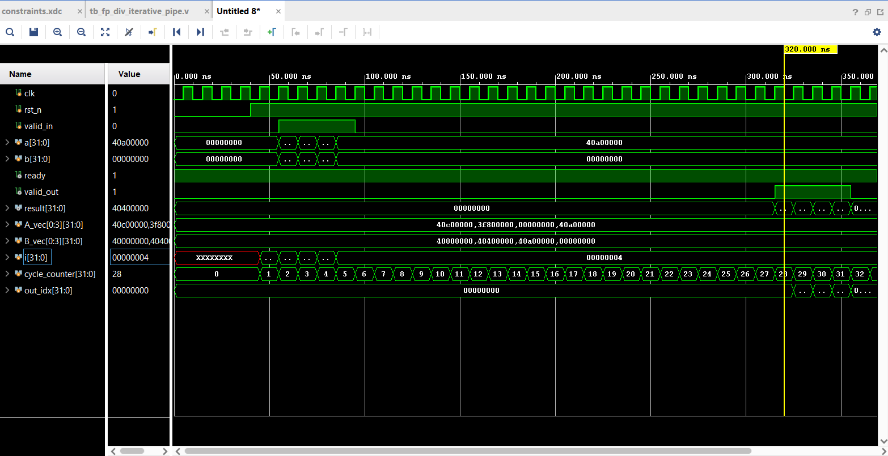
SUBTRACTIVE PIPELINED DIVIDER
2. Waveform

Slide 21
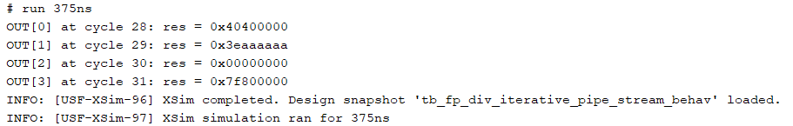
SUBTRACTIVE PIPELINED DIVIDER
3. TCL Console Output

Slide 22
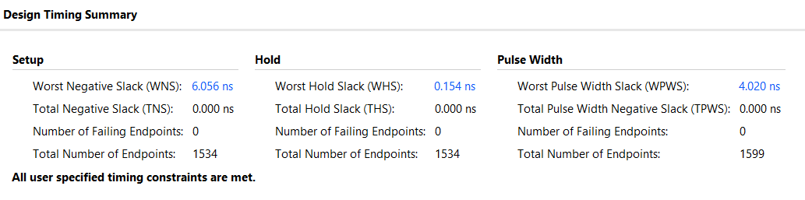
SUBTRACTIVE PIPELINED DIVIDER
4. Design Timing Summary

Slide 23
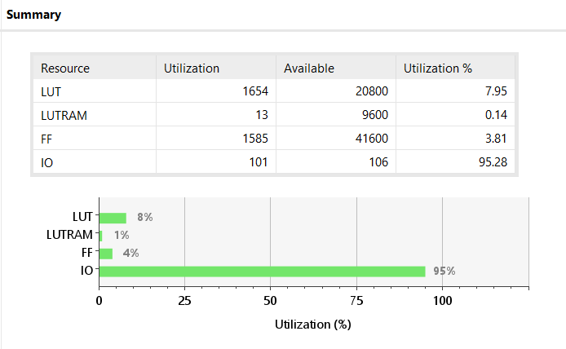
SUBTRACTIVE PIPELINED DIVIDER
5. Utilization

Slide 24
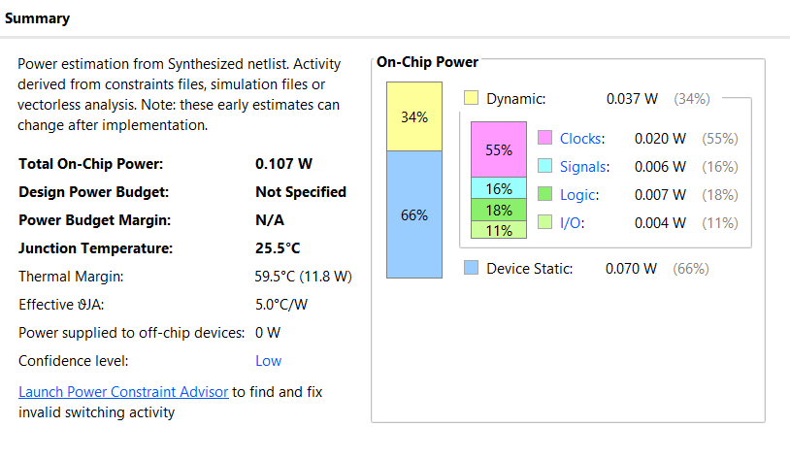
SUBTRACTIVE PIPELINED DIVIDER
6. Power

Slide 25
Comparison and Observations
Overall comparison
IEEE-754 Divider IP
Area: Medium LUT/FF but likely uses DSPs; more complex.
Power: Highest dynamic power (~53 mW).
Latency: 29 cycles.
Throughput: 1 result per cycle when pipelined.
Best use case: When full IEEE-754 compliance and robust corner-case handling are more important than area and power.
Non-pipelined subtractive divider
Area: Very small (0.75% LUT, 0.42% FF).
Power: Lowest dynamic power (~6 mW).
Latency: ~28 cycles.
Throughput: 1 result every 28 cycles (~3.5 M div/s at 100 MHz).
Best use case: Area- and power-constrained systems where only occasional divisions are needed, and throughput is not critical.

Slide 26
Pipelined subtractive divider
Area: Largest (7.95% LUT, 3.81% FF).
Power: Medium dynamic power (~37 mW).
Latency: ~27 cycles.
Throughput: 1 result per cycle (~100 M div/s at 100 MHz).
Best use case: Custom design where we want high throughput floating-point division but are willing to pay area/power for it, while still using a simple subtractive algorithm (no DSPs).

Slide 27
Conclusions
Latency is dominated by the mantissa division algorithm. The Xilinx IP uses a far more optimized internal algorithm (Newton–Raphson or Goldschmidt), giving much lower latency than iterative subtractive methods.
Throughput is dramatically improved by pipelining. The pipelined subtractive divider offers ~29× higher throughput than the non-pipelined version, despite similar latency.
Area increases sharply when moving from iterative to pipelined design, because pipelining replicates hardware across stages. The IP core is optimized for area efficiency using DSP blocks.
All designs can operate above 200 MHz. MaximumThe non-pipelined design has the lowest power, only 6 mW dynamic, because only one subtractor is active at a time.
The pipelined design has significantly higher switching activity (~37 mW), due to 24 active stages.
The IEEE-754 IP has the highest dynamic power (~53 mW), caused by DSP usage and larger internal arithmetic units.
Frequency is not a limiting factor in any of the architectures.

